Slide 1
Document Type Definition (DTD)
B. Prabavathy

Slide 2
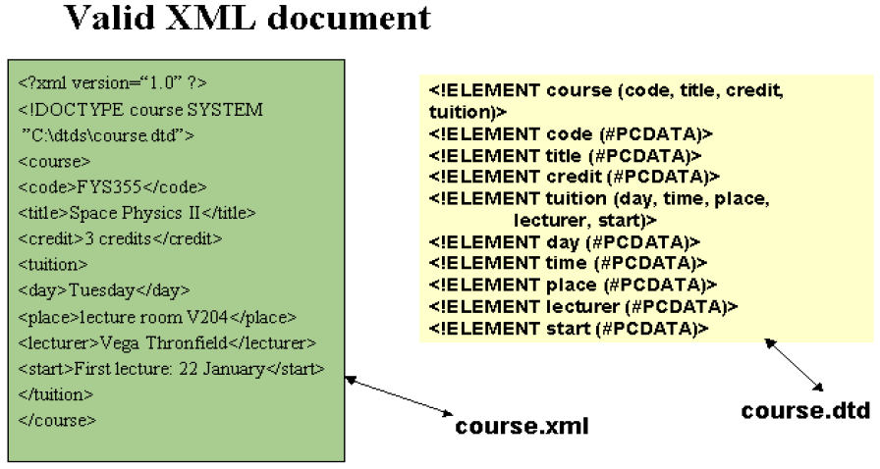

Slide 3
Why DTD?
DTD is used to check whether the XML document is valid or not
Defines legal building blocks of XML document
Specifies the document structure with a list of legal elements
Specifies the order and quantity of the elements that can be contained within the element being declared
A DTD can be declared inline inside an XML document, or as an external reference
DTD cannot specify all the constraints that arise in XML document
Greater subset of constraints can be specified in XML Schema

Slide 4
DTD Declaration
If the DTD is declared inside the XML file, it should be
wrapped in a DOCTYPE definition with the following syntax:
<!DOCTYPE root-element [element-declarations]>
If the DTD is declared in an external file, it should be wrapped in a DOCTYPE definition with the following syntax:
<!DOCTYPE root-element SYSTEM "filename">

Slide 5
DTD Building Blocks
XML documents (and HTML documents) are made up by the following building blocks
  Elements
  Attributes
  PCDATA
  CDATA

Slide 6
PCDATA, CDATA
PCDATA means parsed character data.
Character data is the text found between the start tag and the end tag of an XML element.
PCDATA is text that will be parsed by a parser.
Tags inside the text will be treated as markup and entities will be expanded.
CDATA means character data. CDATA is text that will not be parsed by a parser.
Tags inside the text will not be treated as markup and entities will not be expanded.

Slide 7
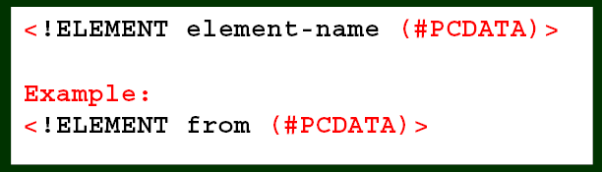
ELEMENT with PCDATA
Elements with Parsed Character Data
Elements with only parsed character data are declared with #PCDATA inside parentheses

Slide 8
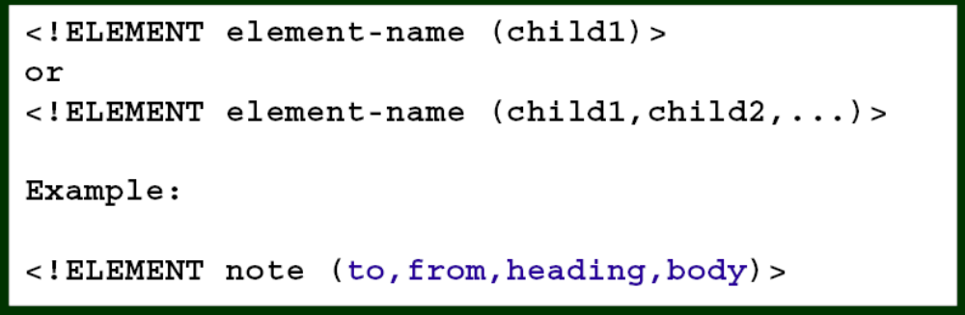
Elements with Children
Elements with one or more children are declared with the name of the children elements inside parentheses
When children are declared in a sequence separated by commas, the children must appear in the same sequence.

Slide 9
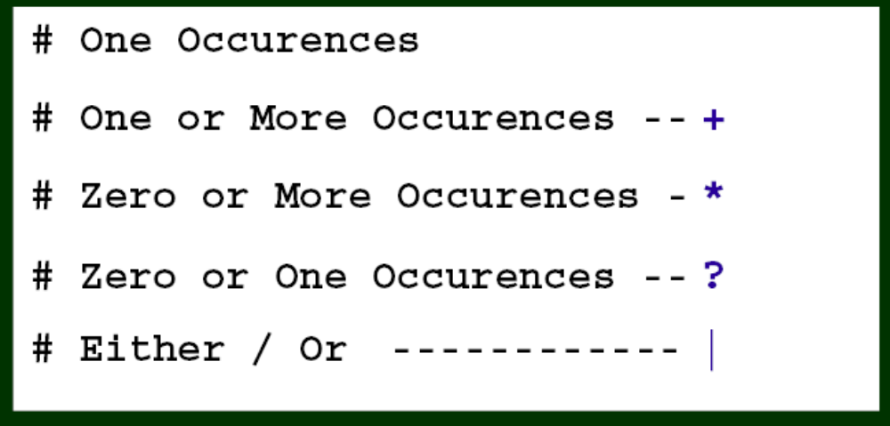
ELEMENTS with occurrence type

Slide 10
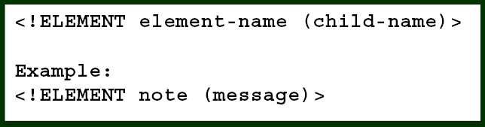
Only One Occurences
The example below declares that the child element "message"
must occur once, and only once inside the "note" element

Slide 11
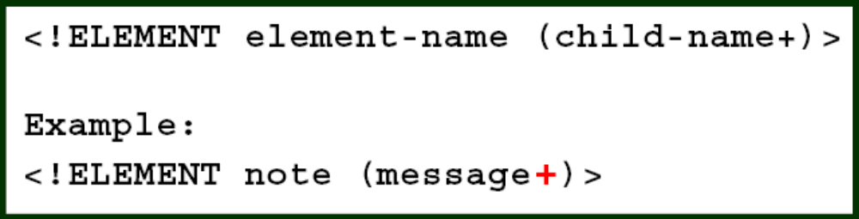
One One or More Occurences
The + sign declares that the child element "message" must occur
one or more times inside the "note" element.

Slide 12
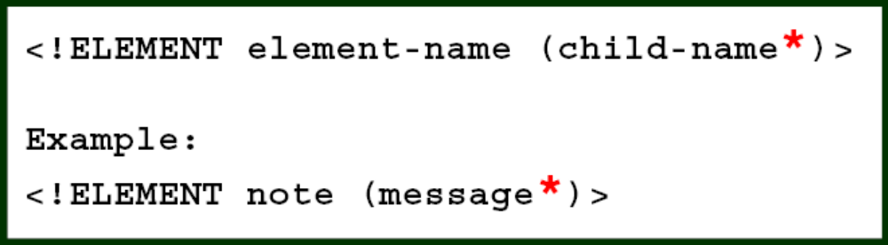
Zero or More Occurrences
The * sign declares that the child element "message" must occur
zero or more times inside the "note" element

Slide 13
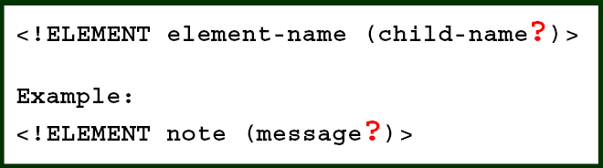
Zero or One Occurrences
The ? sign declares that the child element "message" must occur
zero or one times inside the "note" element.

Slide 14
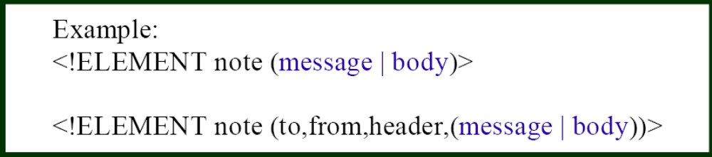
either/or Content
"note" element must contain either a "message" or a "body“ element.

Slide 15
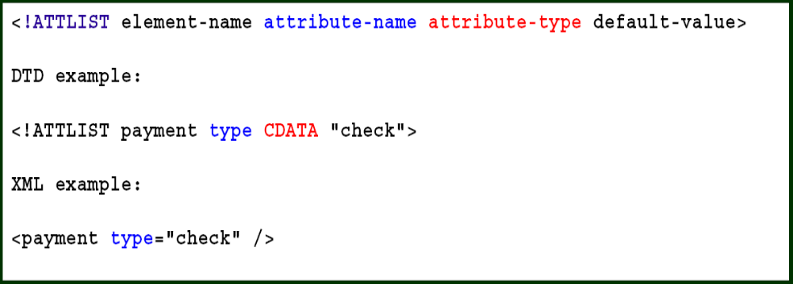
Declaring Attributes
Attributes are declared with an ATTLIST declaration.

Slide 16
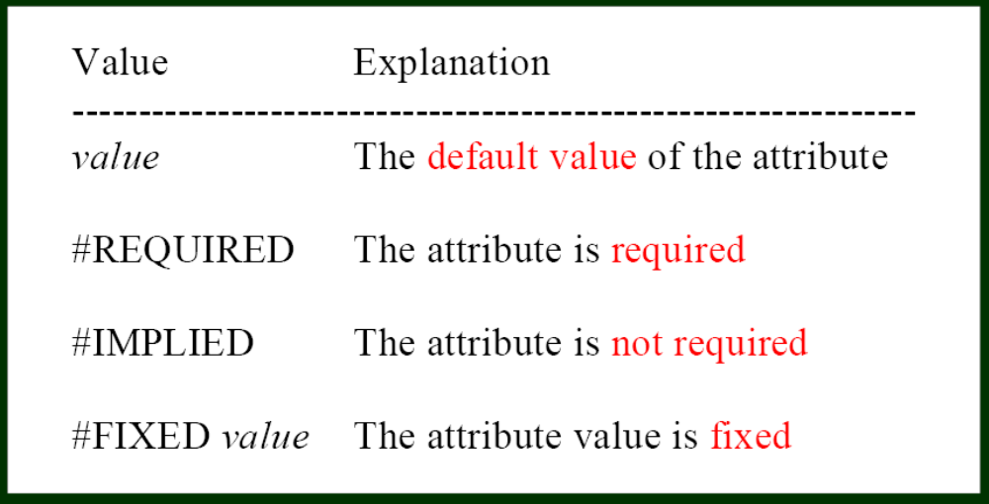
Attribute -Values

Slide 17
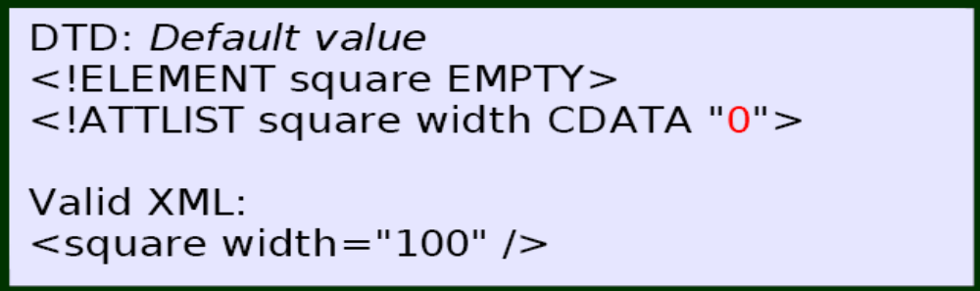
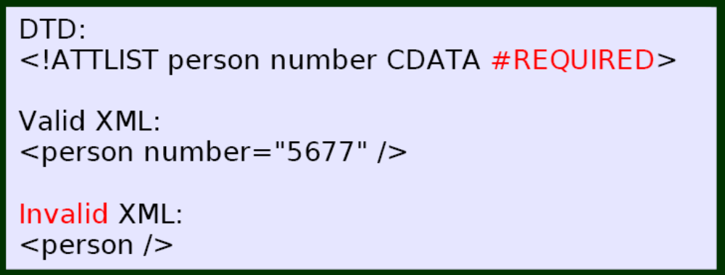
Examples

Slide 18
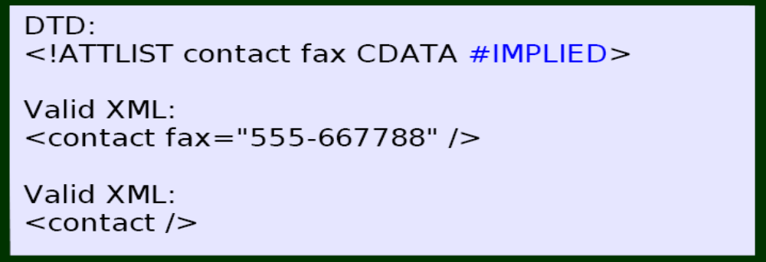
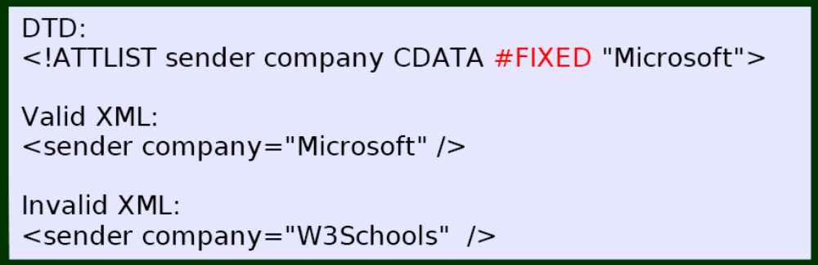
Examples

Slide 19
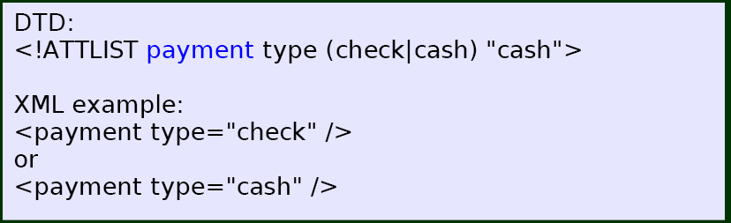
Enumerated Values
Syntax:
<!ATTLIST element-name attribute-name (en1|en2|..) default-value>

